Slide 1
Clinical Block 2

Slide 2
So, we ran a study:
 | Disease | Non Disease | Total
Group 1 |  |  | Sample Group 1
Group 2 |  |  | Sample Group 2
 | Total Disease | Total Non Disease | Total

Slide 3
Event Rates
Outcome present / total in group
 | Disease | Non Disease | Total
Group 1 |  |  | Sample Group 1
Group 2 |  |  | Sample Group 2
 | Total Disease | Total Non Disease | Total

Slide 4
Relative Risk
RR is the ratio of the risk in the experimental group compared to the risk in the control group.
Online Control = Group 2
Rate group 1 / rate group 2
 | Disease | Non Disease | Total
Group 1 |  |  | Sample Group 1
Group 2 |  |  | Sample Group 2
 | Total Disease | Total Non Disease | Total

Slide 5
Odds for each group
Ratio of presence of a disease to absence after study
 | Disease | Non Disease | Total
Group 1 |  |  | Sample Group 1
Group 2 |  |  | Sample Group 2
 | Total Disease | Total Non Disease | Total

Slide 6
Odds Ratio
OR is the ratio of the odds in the experimental group compared to the odds in the control group.
Online Control = Group 2
Odds group 1 / Odds group 2
LOG Odds is the natural log of the odds ratio.
 | Disease | Non Disease | Total
Group 1 |  |  | Sample Group 1
Group 2 |  |  | Sample Group 2
 | Total Disease | Total Non Disease | Total

Slide 7
Calculate these values!
http://vassarstats.net/odds2x2.html
Watch the order of the boxes…

Slide 8
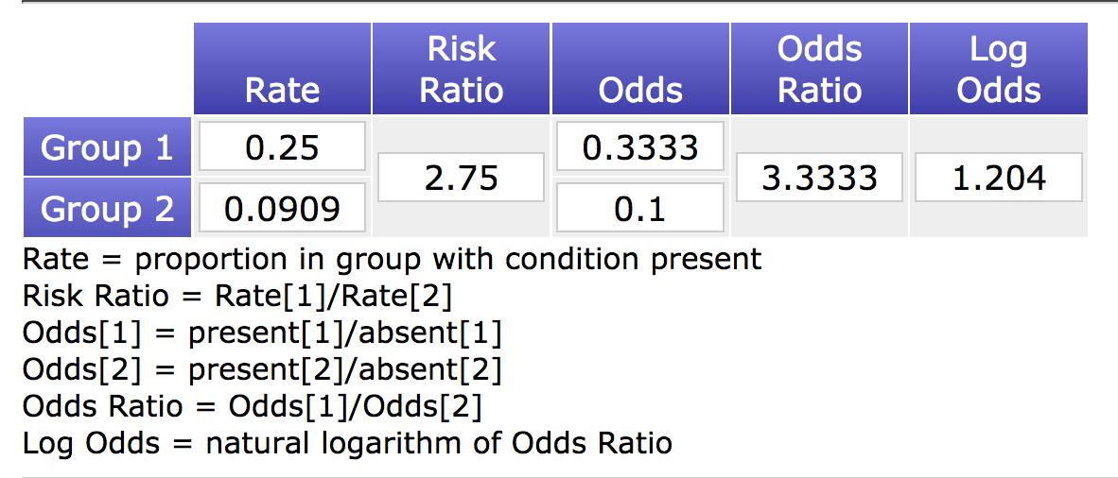
Absolute Benefit Increase
ABI is the difference between the rates of events in the experimental and control group, also called Absolute Risk Reduction
Rate Group 1 – Rate Group 2
.25 - .09 = .16
Remember that a negative number implies risk reduction, while positive numbers imply risk increase.

Slide 9
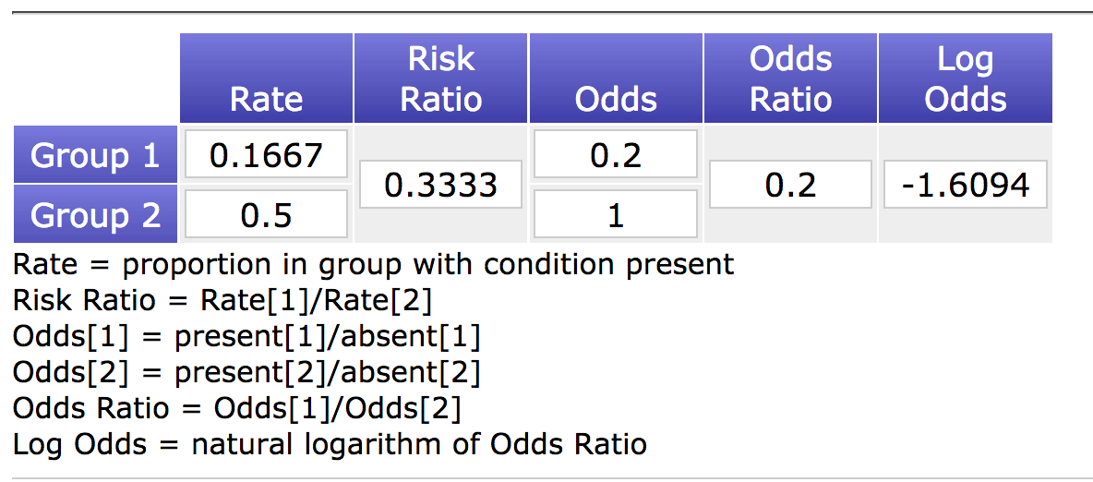
Absolute Benefit Increase
ABI is the difference between the rates of events in the experimental and control group, also called Absolute Risk Reduction
Rate Group 1 – Rate Group 2
.17 - .50 = -.33
Remember that a negative number implies risk reduction, while positive numbers imply risk increase.

Slide 10
Numbers Needed to Treat
NNT is the number of patients who need to be treated to prevent one bad outcome or produce one good outcome.
In other words, it is the number of patients that a clinician would have to treat with the experimental treatment compared to the control treatment to achieve one additional patient with a favorable outcome.
1/ABI or ARR
1/.16 = 6.25 (this case would be numbers needed to harm)
1/-.33 = -3.03 (this case would be numbers needed to treat)
Remember that negative numbers imply risk reduction, so you can reduce the population disease by treating XX people. It appears most people reverse the sign, I find this confusing as well ☹.

